Slide 1
Matplotlib Architecture Analysis
SOEN 6471 - Advanced Software Architecture
Team G
Student Name | Student ID
Diego Palacios | 40270954
Jayasurya Pazhani | 40289512
Shahul Hameed Pichhi Thameenansari Syedmeera | 40290787
May 21st 2025

Slide 2
Agenda
Introduction to Matplotlib
Key Characteristics & Features
Layered Architecture
Context of Use Model
Class UML Diagram
Stakeholder Model
Stakeholder Class Diagram
Stakeholder Mind-Map
Summary
References

Slide 3
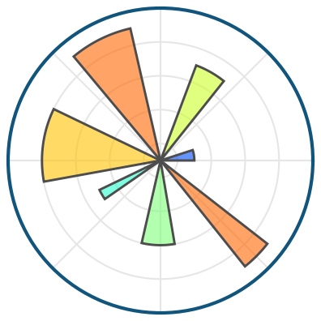

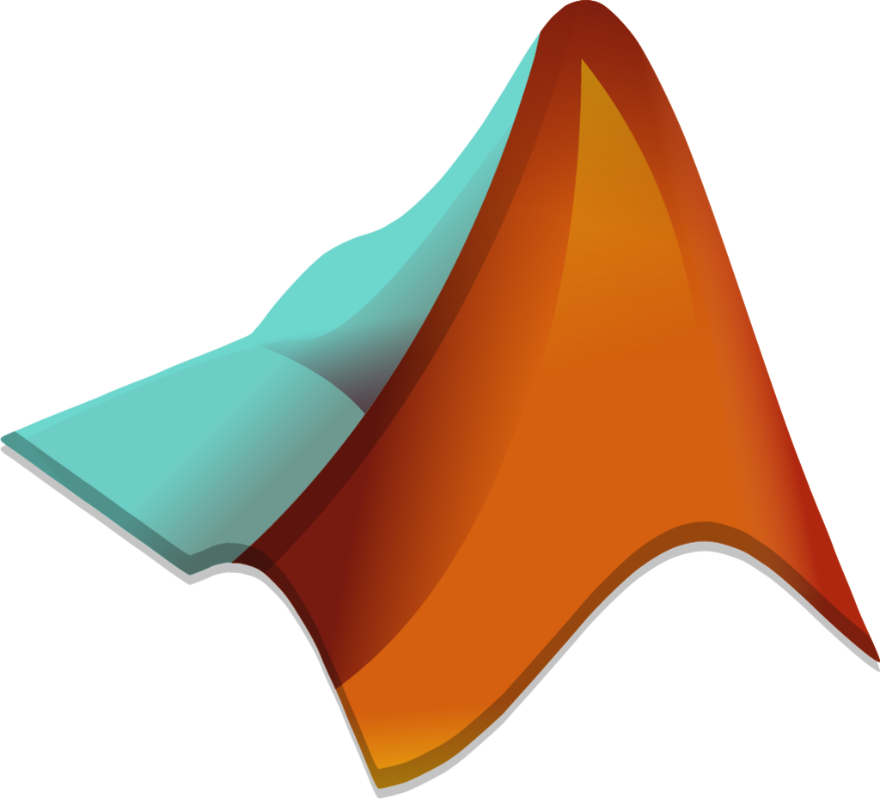
What is Matplotlib?
Is an open source 2D plotting tool made for Python.
It was created in the early 2000s by John D. Hunter with the purpose of replicating and even extending the plotting capabilities of Matlab using pythons flexibility.
Remains as a core component of data analysis and visualization in scientific computing ecosystems.

Slide 4
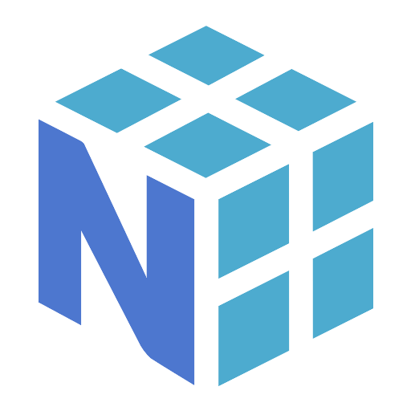
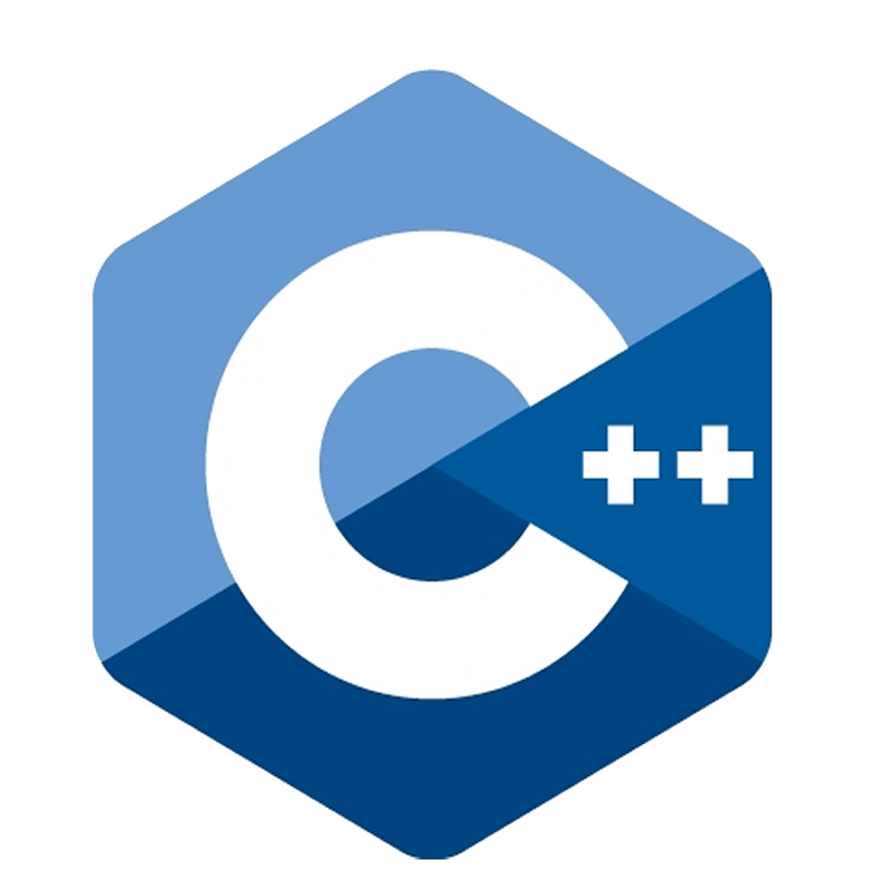
Characteristics and Features
Enables flexible plotting including special support for histograms and heatmaps
Supports a double interface:
Pyplot interface inside the matplotlib.pyplot module
Object-oriented API for a more programmable approach
Extended support for extensions
Multiple render format outputs (PNG, JPG, PDF, SVG, PS, LaTeX)
Reliability on external libraries like NumPy and Anti-Grain Geometry (AGG) for a high performance rendering

Slide 5
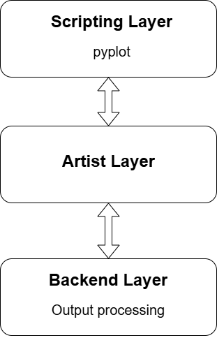
Architecture
Matplotlibs architecture is structured between 3 entities:
Scripting Layer: corresponding to the matplotlib.pyplot module, provides an interface for the user similar to the one established for MATLAB.
Artist Layer: constructs the visual representation of the data after the input process. It doesn’t know the the format being used for the output since it’s not its task.
Backend Layer: is in charge of rendering the drawings processed by the Artist Layer as well as adding support for interactive plots (actions like selecting or zooming).

Slide 6
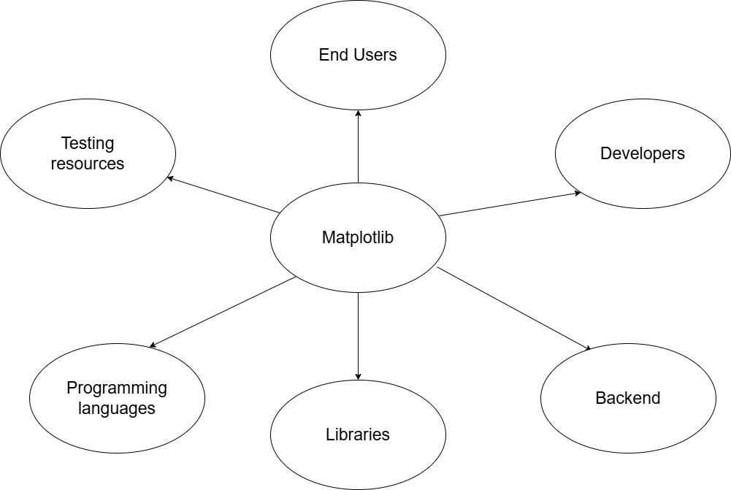
Context of Use Model

Slide 7
Context of Use Model
Breaking down the models components we get:
End Users: normally scientists and researchers in need to visualize experiments and processed data
Developers: different open-source developers are contributing to the Matplotlib GitHub repository, as well as other academic affiliates and even companies like Nasa
Backend: tools like Tkinter and wxPython are used to connect the plotting in Matplotlib to a GUI with the purpose of building an interactive interface

Slide 8
Context of Use Model
Libraries: external libraries are used to give an smoother experience, these include image format libraries and libraries for numerical operations like NumPy
Programming languages: Matplotlib is mainly developed for python, however, it’s rendergin functionalities granted by the previously mentioned AGG library is powered by C++
Testing Resources: because of the CI pipelines implemented for the development, tools like pytest and Tox are used for testing and integration purposes

Slide 9
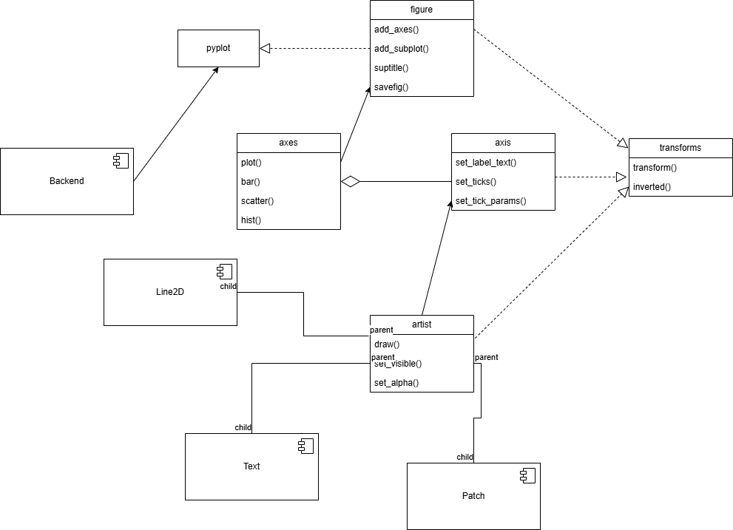
UML Class Diagram

Slide 10
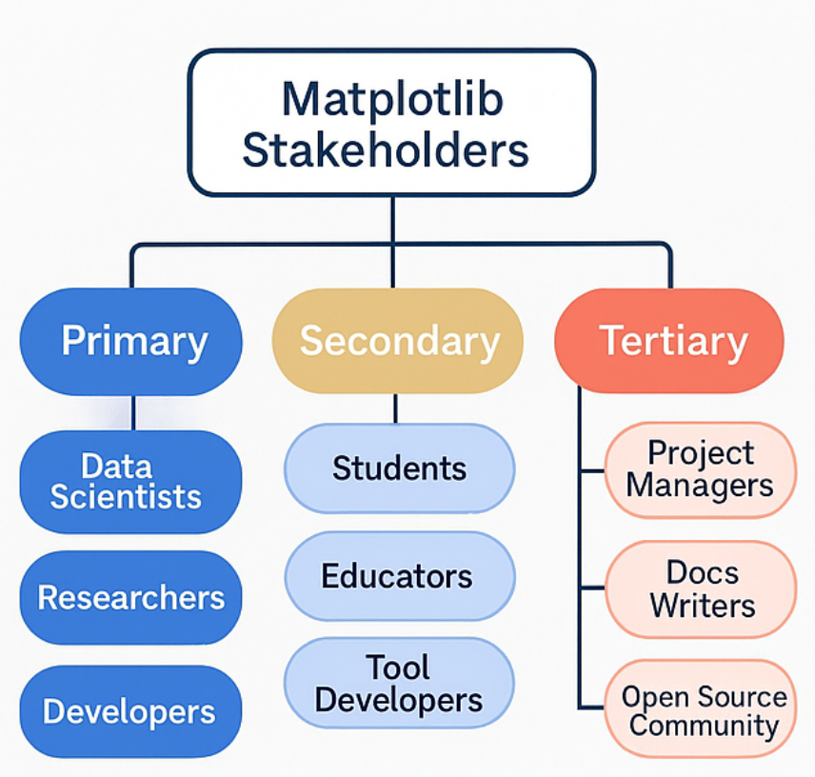
Stakeholder Model of Matplotlib
Stakeholders are individuals or groups who interact with or are affected by the system.
They are categorized as:
Primary – Direct users and core contributors
Secondary – Indirect users and integrators
Tertiary – Peripheral or support participants

Slide 11
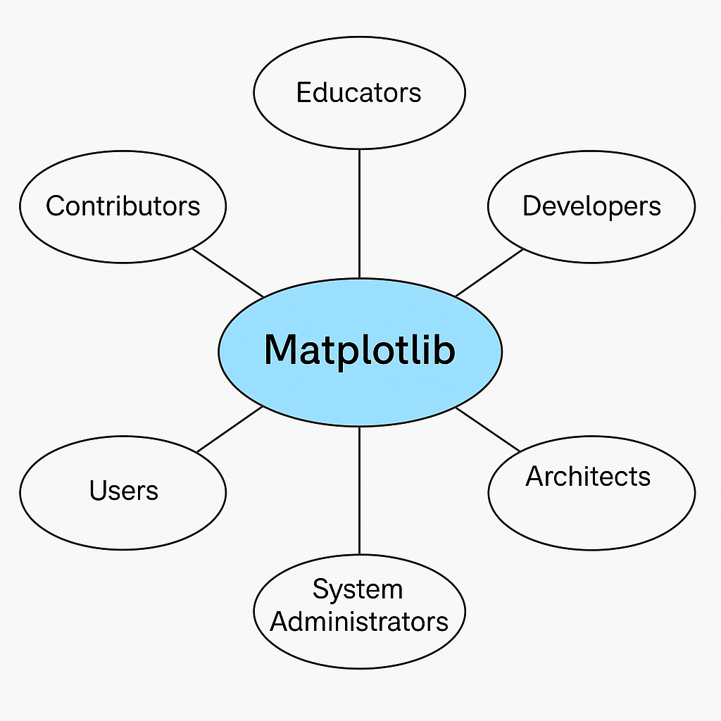
Understanding Stakeholder Models
A stakeholder model identifies and classifies all relevant users and contributors to a system.
Helps in understanding:
Who uses the system?
Who maintains or extends it?
Who benefits from or is influenced by it?
It is useful for aligning architecture with real-world usage needs.

Slide 12
Primary Stakeholders
Stakeholders | Role
Data Scientist | Use Matplotlib to build analytical visualizations and dashboards.
Scientific Researcher | Rely on it for generating figures in academic papers and studies.
Software Developer | Integrate Matplotlib in applications and libraries, and it requires stable APIs.

Slide 13
Secondary Stakeholders
Stakeholders | Role
Student | Use Matplotlib to learn programming and data visualization.
Educators | Demonstrate visual concepts in teaching materials and lectures.
Tool Developers | Extend Matplotlib via tools like Seaborn or wrappers.
Backend Maintainers | Maintain rendering engines (Agg, TkAgg) used by Matplotlib.

Slide 14
Tertiary Stakeholders
Stakeholders | Role
Project Managers | Oversee teams using Matplotlib in reporting pipelines.
Document Writers | Ensure guides and tutorials are up to date and user-friendly.
Open-Source Community | Report bugs, contribute code, and shape the project’s future.

Slide 15
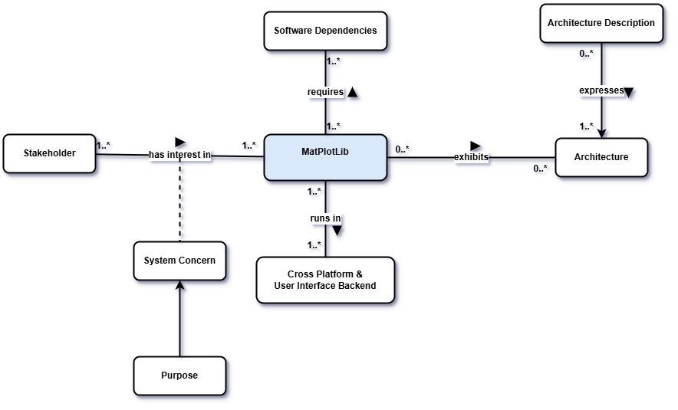
Stakeholder Model Class Diagram

Slide 16
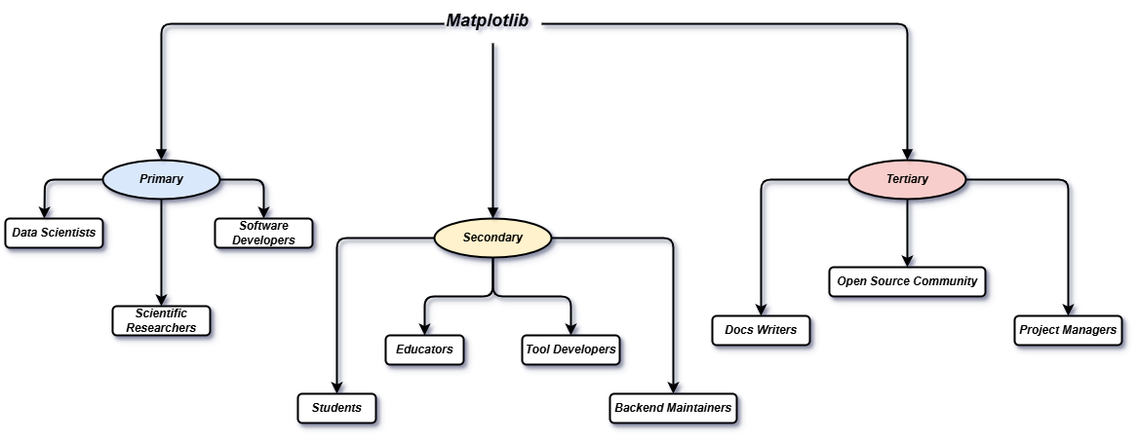
Stakeholder Mind-Map

Slide 17
Summary
Matplotlib is a powerful open-source 2D plotting library in Python, widely used in scientific and academic domains.
It features a three-layer architecture: Scripting (Pyplot), Artist, and Backend.
Used by various stakeholders including scientists, developers, educators, and tool integrators.
Plays a vital role in the Python data science ecosystem, supporting both static and interactive plotting.
Its architecture balances usability, flexibility, and extensibility, making it a core visualization tool for over 20 years.

Slide 18
References
[1] J. D. Hunter, "Matplotlib: A 2D Graphics Environment," Computing in Science & Engineering, vol. 9, no. 3, pp. 90–95, 2007, doi: 10.1109/MCSE.2007.55.
[2] M. Droettboom et al., “The Architecture of Matplotlib,” in The Architecture of Open Source Applications – Volume II: Structure, Scale, and a Few More Fearless Hacks, G. Wilson and A. Baxter, Eds. 2012.
[3] DESOSA Team, "Matplotlib – The Python 2D Plotting Library," in Software Architecture of Open Source Projects, Delft University of Technology, 2017.
[4] J. D. Hunter, Matplotlib documentation – History (2008), matplotlib.org (archived in Matplotlib 3.1.1 Manual).
[5] ISO/IEC/IEEE 42010:2011, Systems and software engineering — Architecture description, International Organization for Standardization, 2011.

